Slide 1
Bringing WiFi Localization to Any WiFi Devices
Tianxiang Li, Haofan Lu, Reza Rezvani, Ali Abedi, Omid Abari
Nov. 15, 2022
Austin, Texas, USA
HotNets’22
Notes:
From UCLA

Slide 2
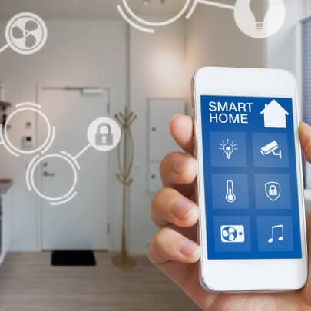
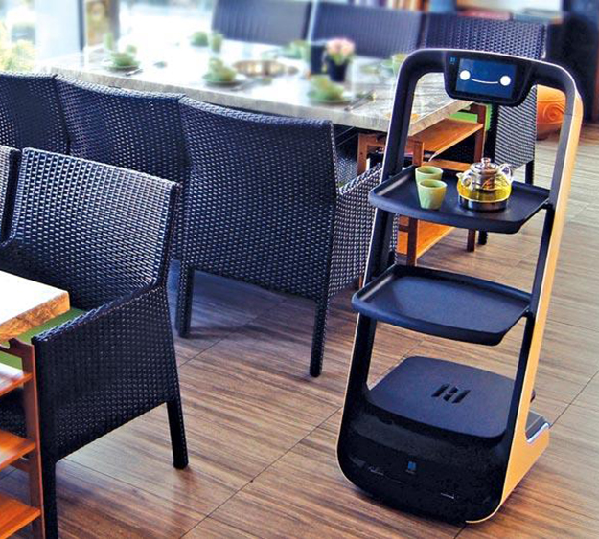
WiFi Localization
Home automation
Smart industry and warehouse
Smart food delivery
Notes:
Explain what is WiFi localization. WiFi device can localize another wifi devices. These technology can enable new applications.
Device to device localization

Slide 3
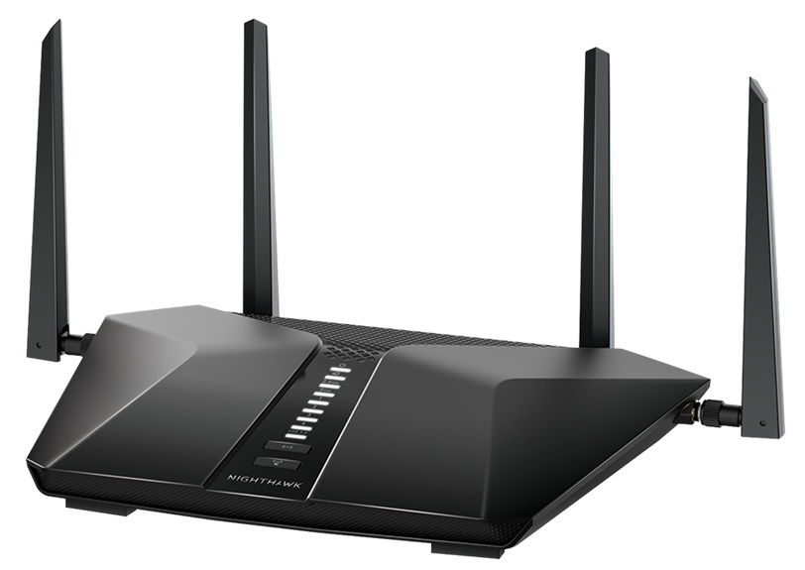
Today’s WiFi Localization Systems
Multiple Access Point Triangulation/Trilateration [SpotFi: Sigcomm’ 15 , ToneTrack: MobiCom’ 15, TyrLoc: MobiSys’ 21]
Single Access Point Trilateration [Chronos: NSDI’ 16, MonoLoco: MobiSys’ 18]
Unfortunately, not all WiFi devices have multiple transceiver chains
$$d_{1}$$
$$d_{2}$$
$$…$$
$$d_{4}$$
Limitation: coordination among multiple access points
Limitation: multiple transceiver chains
Notes:
Put a phone instead of target. For example, all IoT devices don’t have multiple chains.

Slide 4
Can we enable localization with a single transceiver chain?
Notes:
Because if we can do this we can enable any WiFi devices to localize other WIFi devices

Slide 5
WiSight
A system which brings WiFi localization to any WiFi devices
Works as a plug-and-play without modification on the WiFi chipset
Does not require cooperation from other devices
Notes:
Say it more clearly

Slide 6
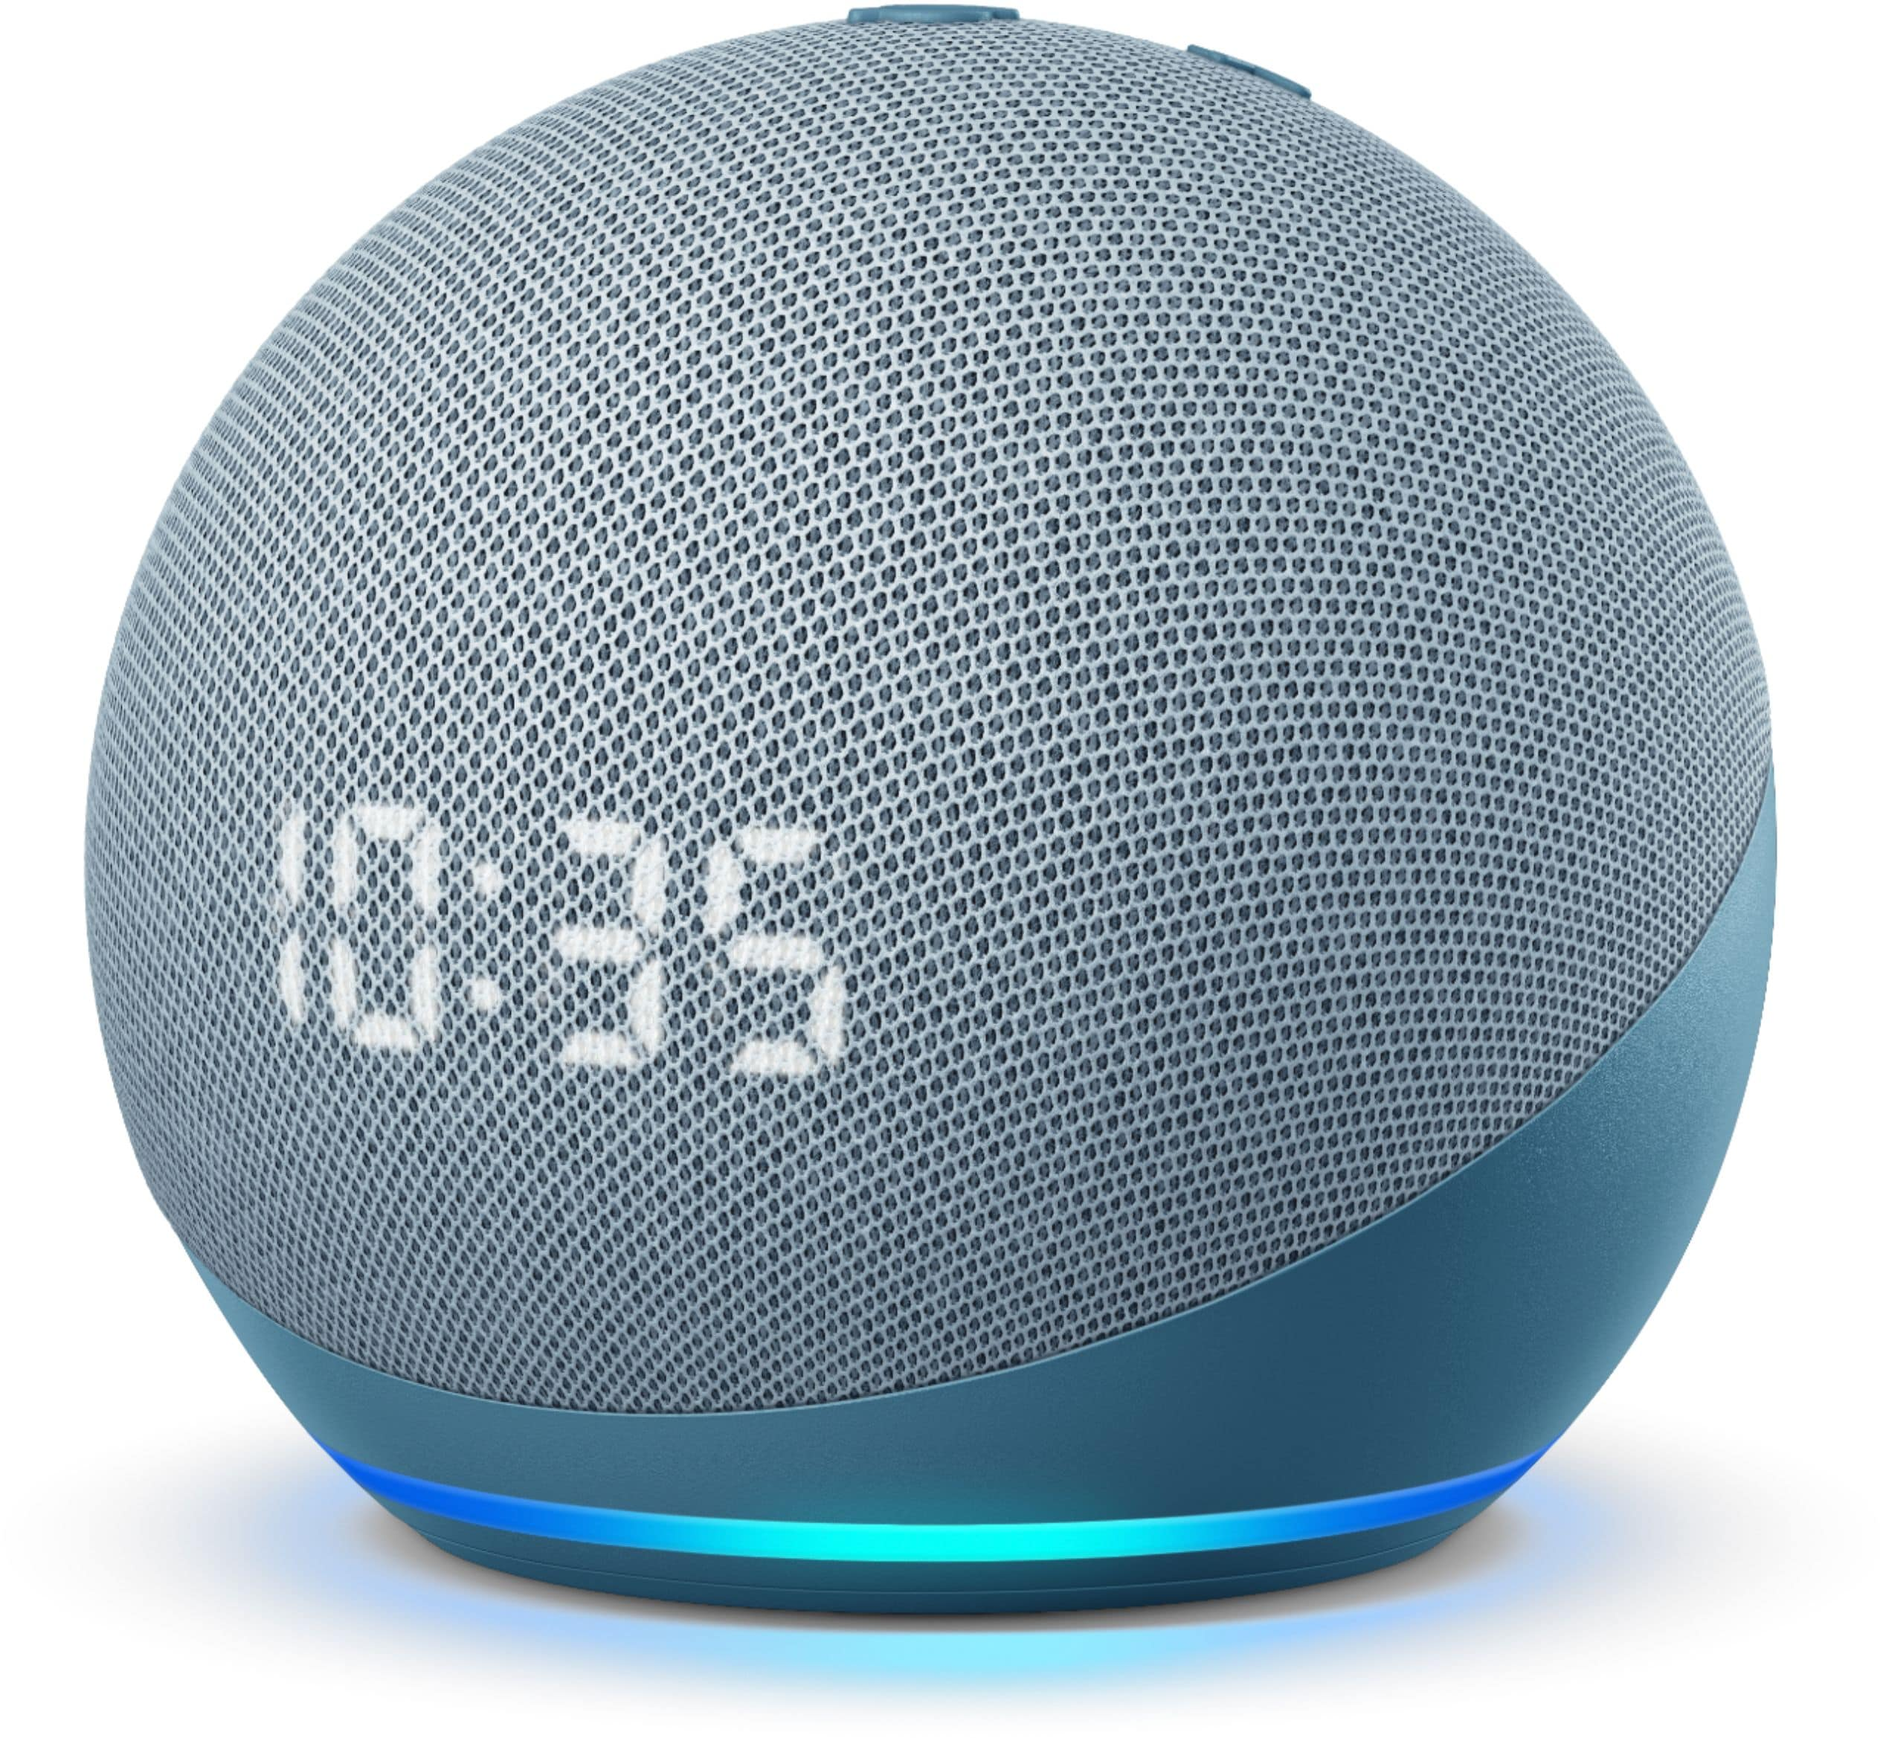
Localization Tasks
Distance
$$distance$$
$$θ$$
Direction
Notes:
Distance: measure the Time of flight using packet and ack. Similar to past work. But let me show direction..

Slide 7
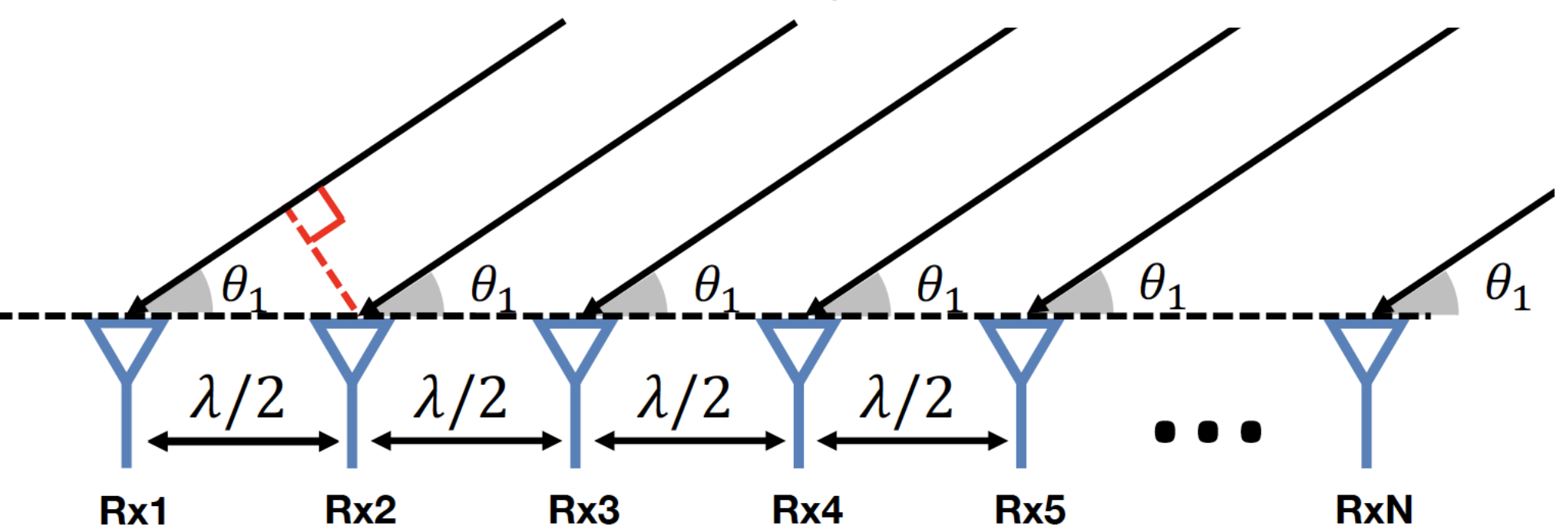
Traditional approach: Antenna Array
Problem: requires multiple transceiver chains
Can we measure direction using a single transceiver chain?
Notes:
Remove lambda/2, red line

Slide 8
Solution: Use Frequency Scanning Antenna (FSA)
There is a one-to-one mapping between frequency and direction
Passive antenna structure
Receives signals of certain frequency in each direction
f₃
f₄
f₂
f₁
…
f_{n}
RF output

Slide 9
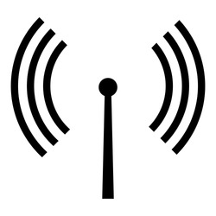
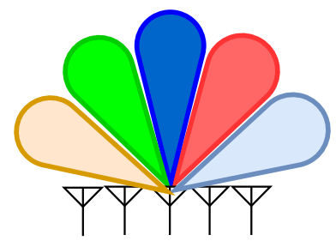
Measuring direction using FSA
Target
$$f_{1}$$
$$f_{4}$$
$$f_{3}$$
$$f_{5}$$
$$f_{2}$$
Received power
$$f_{3}$$
$$f_{2}$$
$$f_{4}$$
$$f_{1}$$
$$f_{5}$$
FSA
$$f_{1}$$
$$f_{2}$$
$$f_{3}$$
$$f_{4}$$
$$f_{5}$$
Frequency channel
WiFi device w/ single chain
WiFi client devices typically only work on a single channel!
Notes:
Show the Wifi device first, try to localize a target device. We disconnect and replace..

Slide 10
Solution: Probing Mechanism of WiFi
Probing is an inherent process of WiFi protocol for finding surrounding APs
WiFi probe request packets are broadcasted by each WiFi device on each frequency channel periodically
Independent of whether the device is connected to a network
FSA + Probing → finding direction using a single transceiver chain
Notes:
Figure show probing

Slide 11
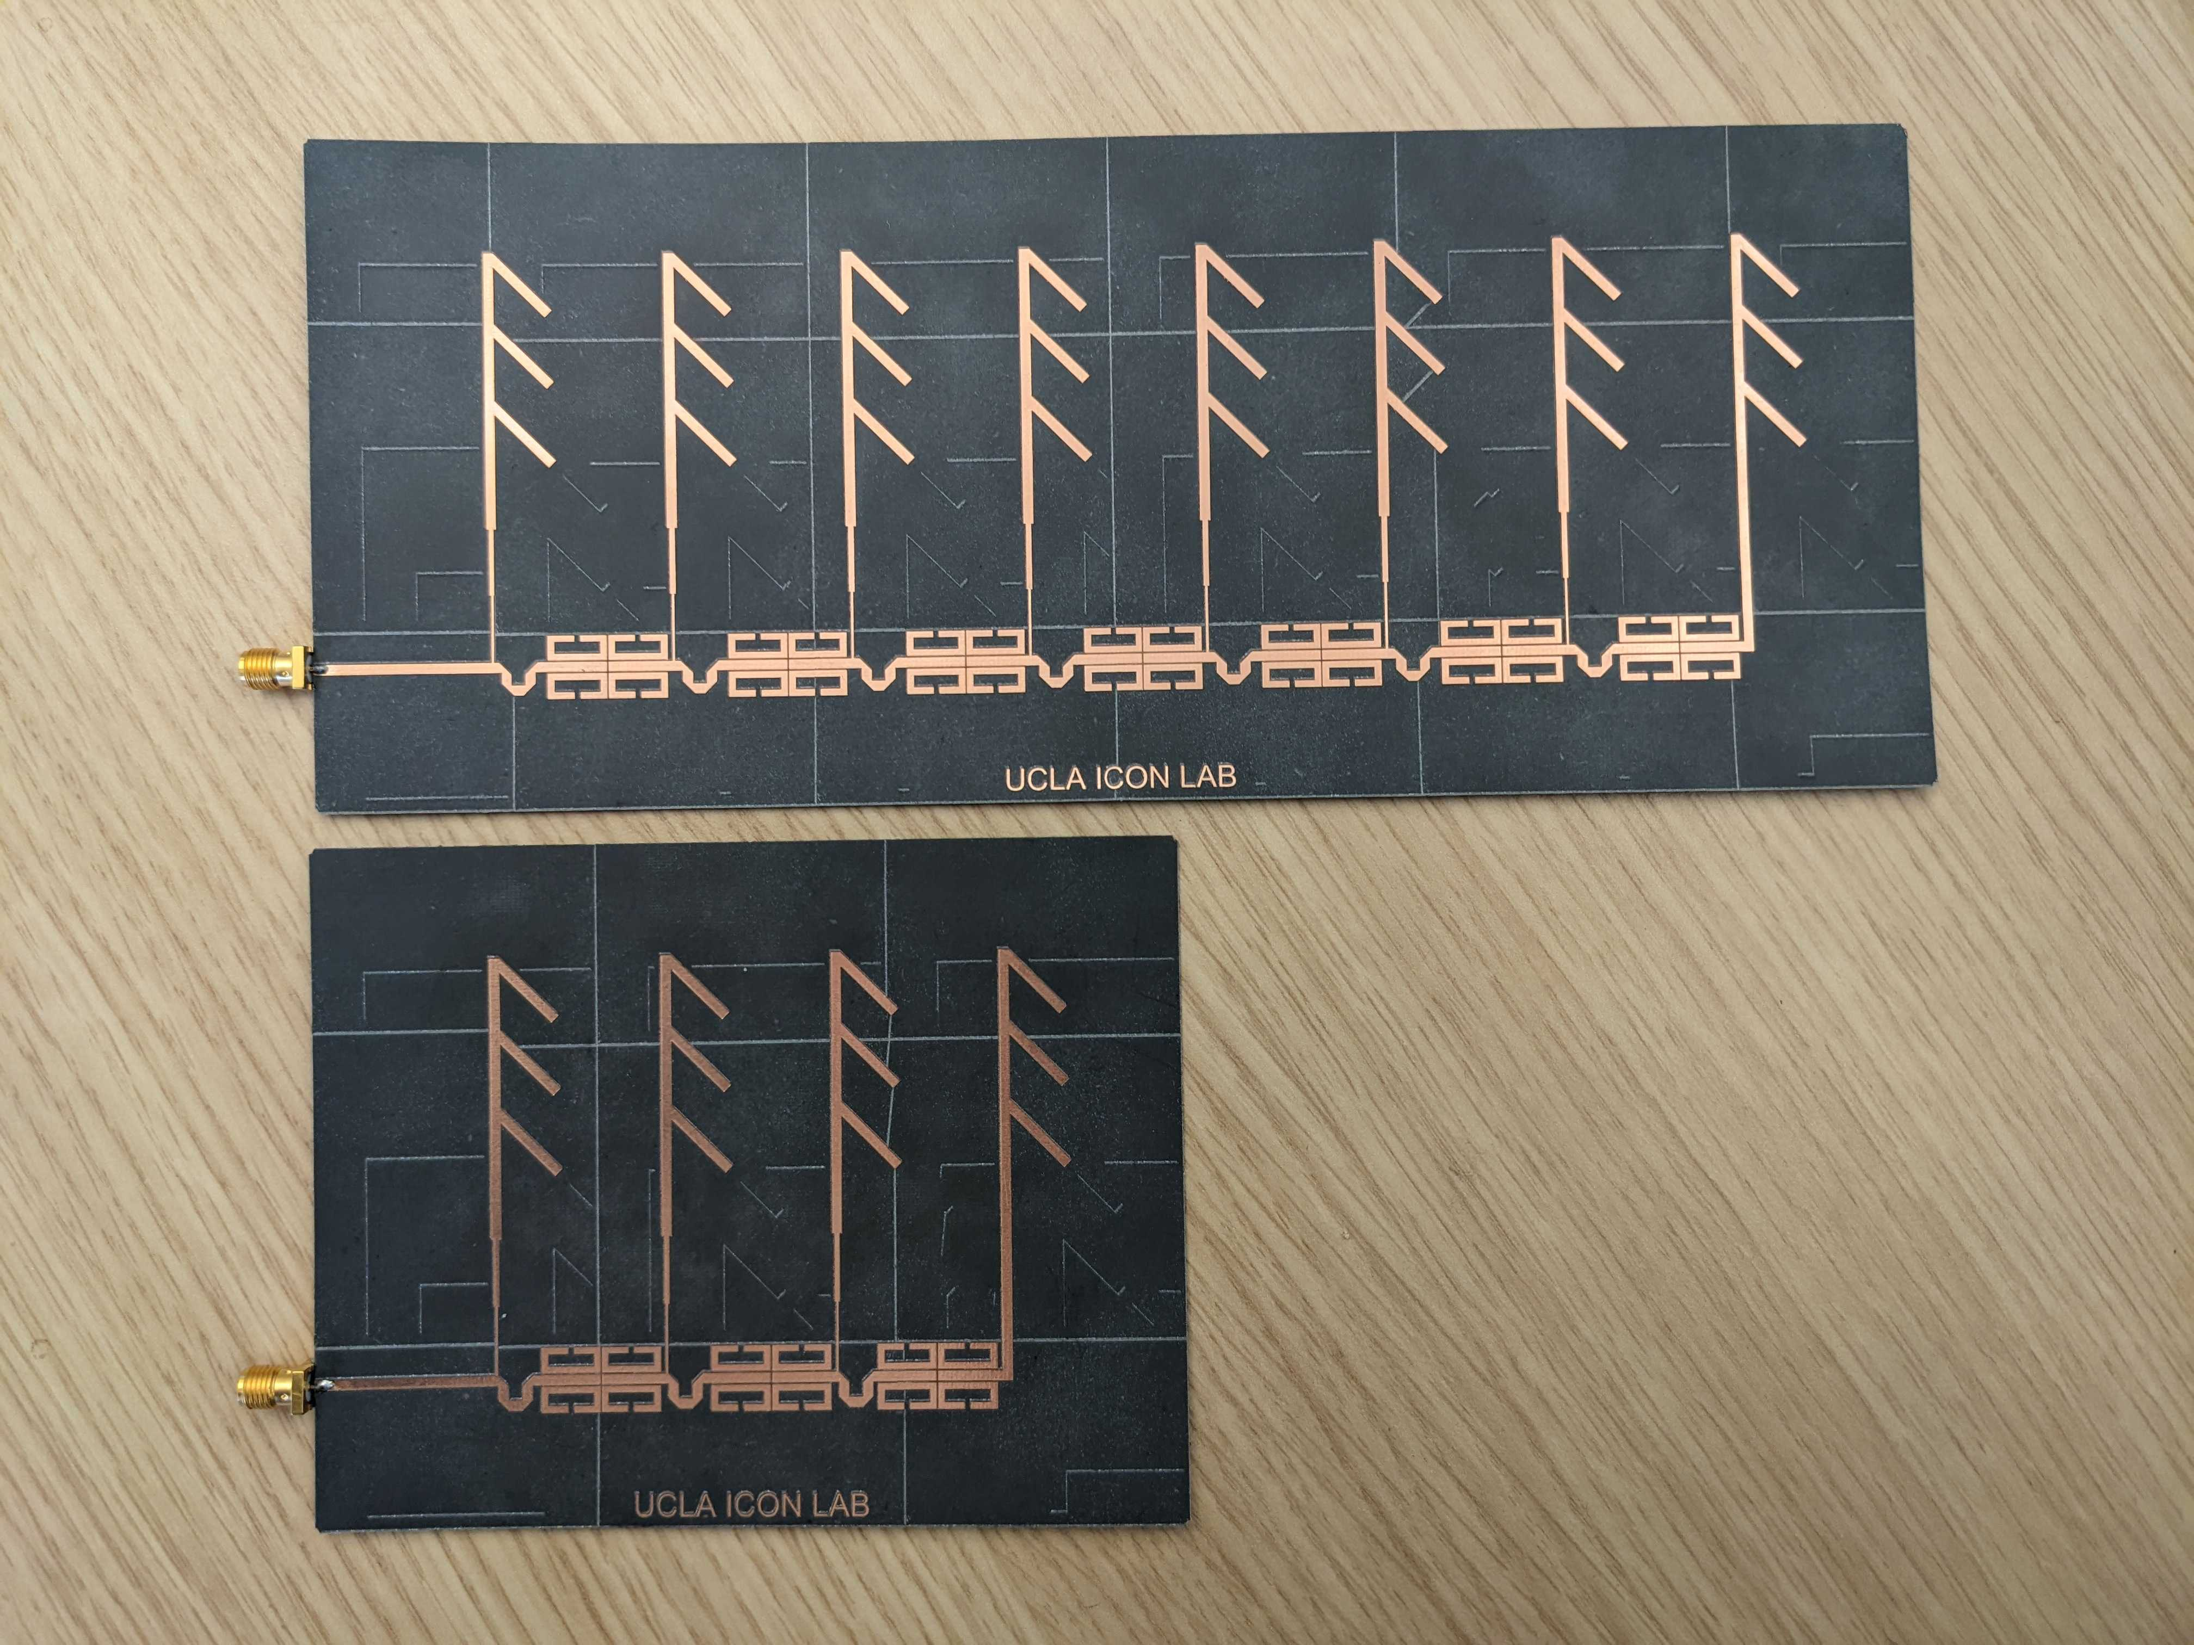
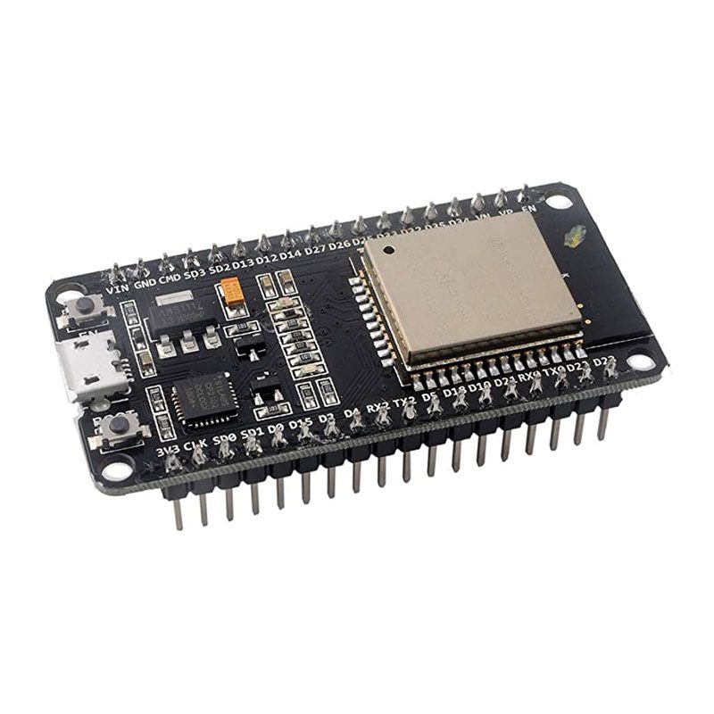
Evaluation
Target
9.5’’
4’’
4’’
5’’
Notes:
Show FSA design, connect it to ESP32, the phone as a target.

Slide 12
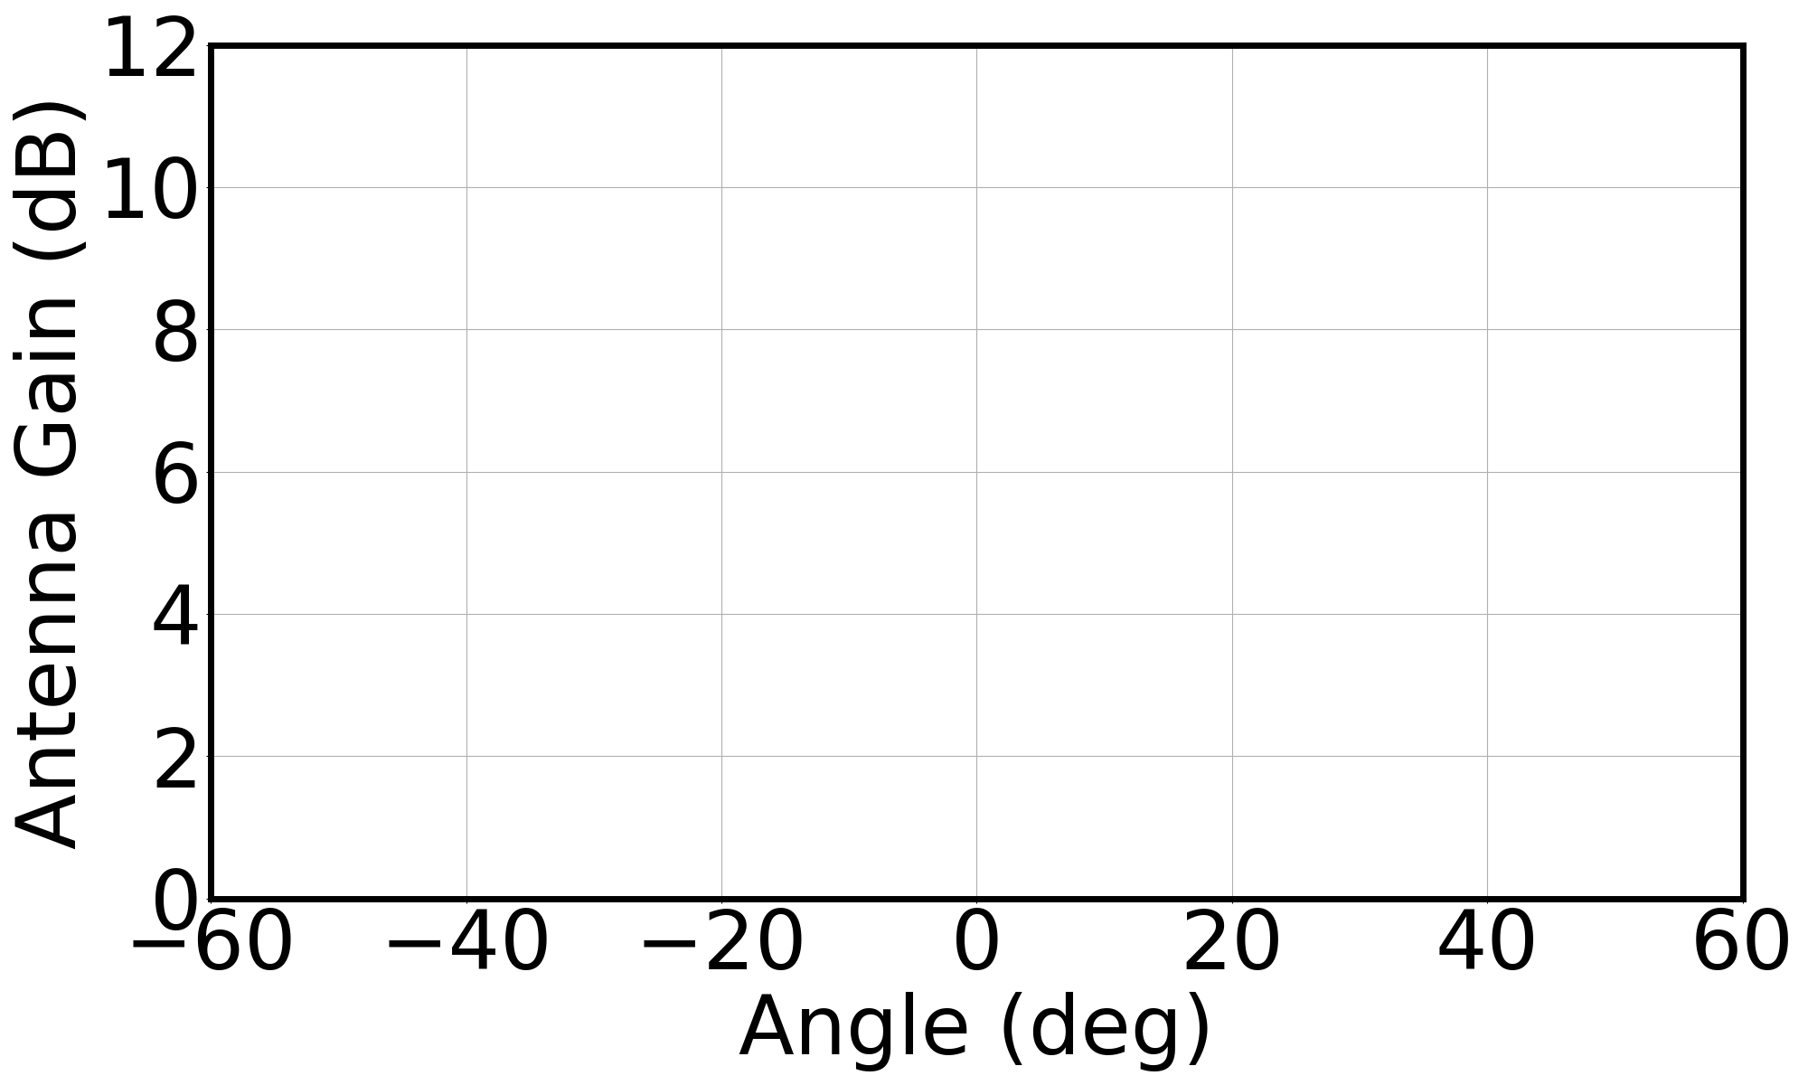
FSA Performance

Slide 13
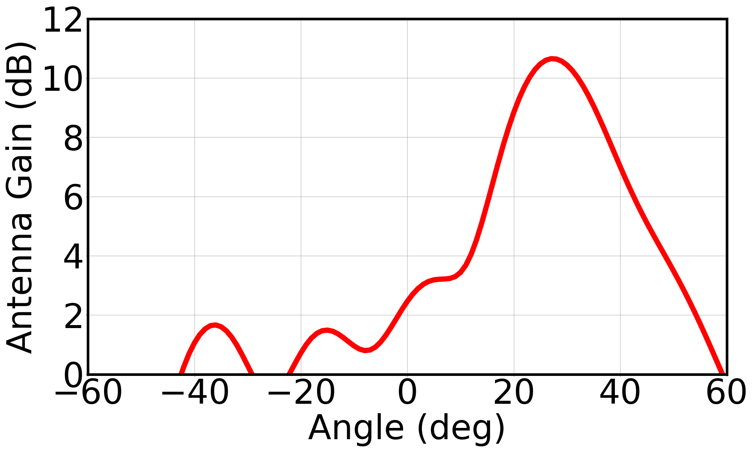
FSA Performance
5.49 GHz
Notes:
It means

Slide 14
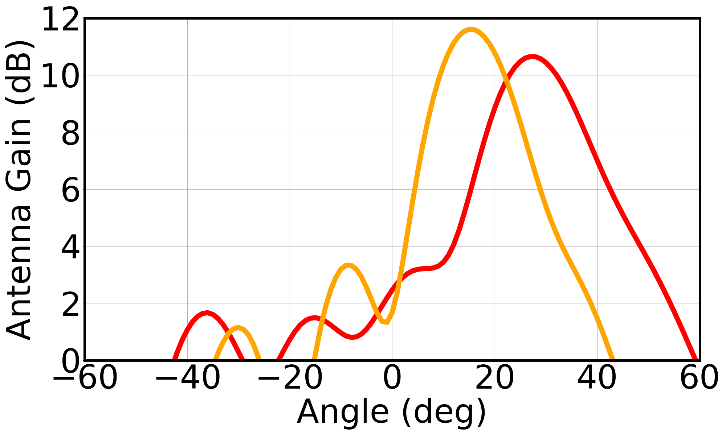
FSA Performance
5.49 GHz
5.57 GHz
Notes:
Change the frequency, the direction moves

Slide 15
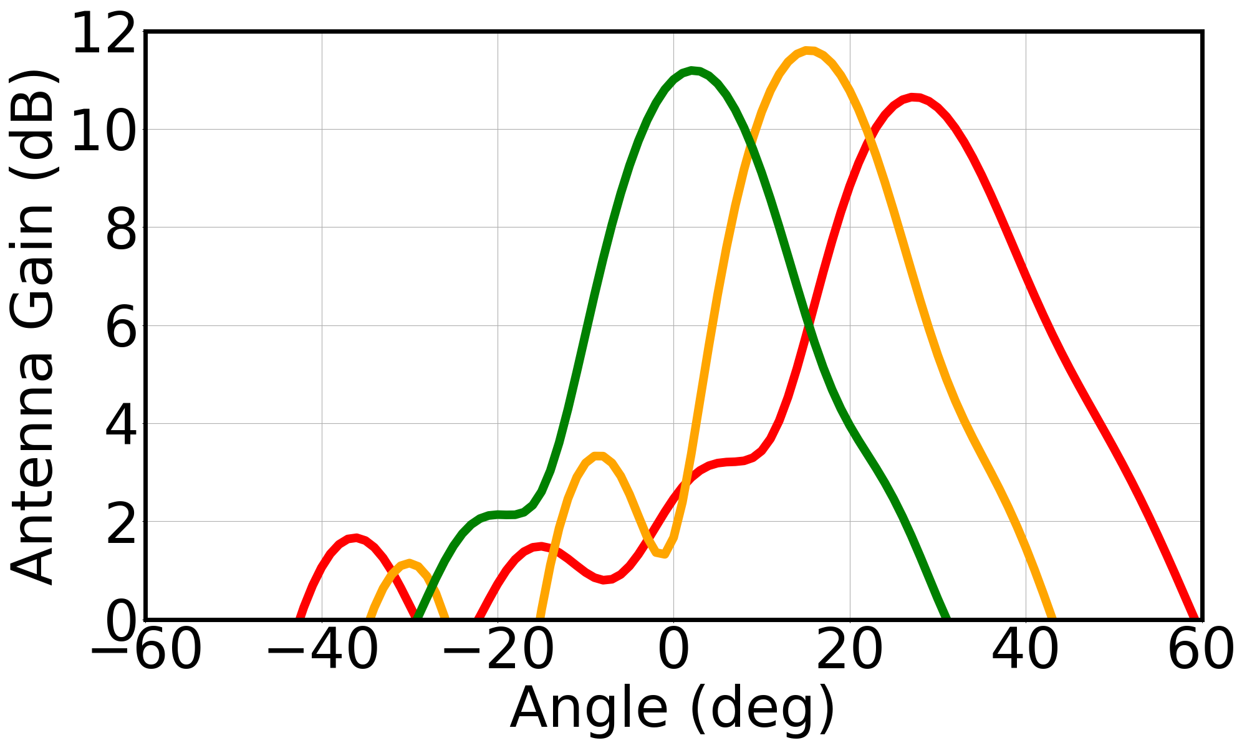
FSA Performance
5.49 GHz
5.57 GHz
5.66 GHz
Notes:
Reiterate FSA: Animation, while box show one beam at a time, then to different frequency

Slide 16
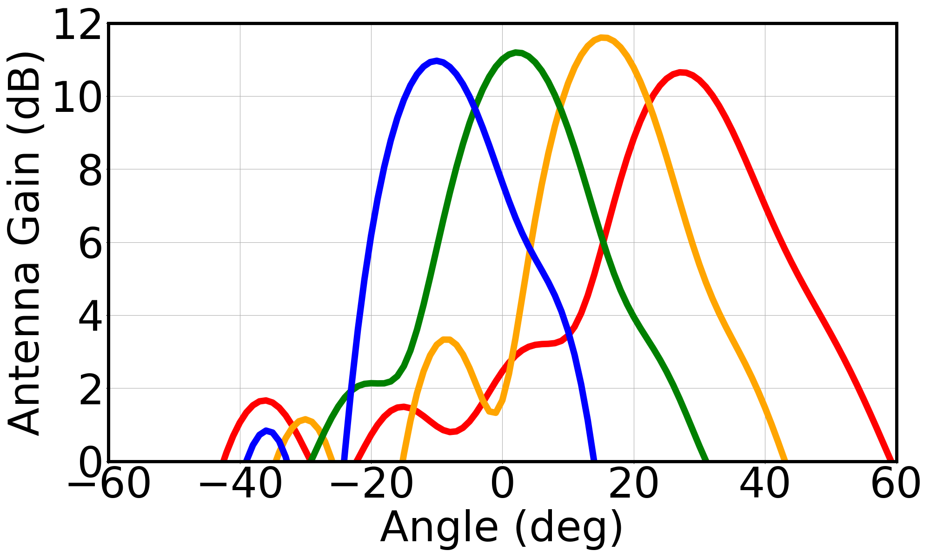
FSA Performance
5.49 GHz
5.57 GHz
5.66 GHz
5.75 GHz
Notes:
Reiterate FSA: Animation, while box show one beam at a time, then to different frequency

Slide 17
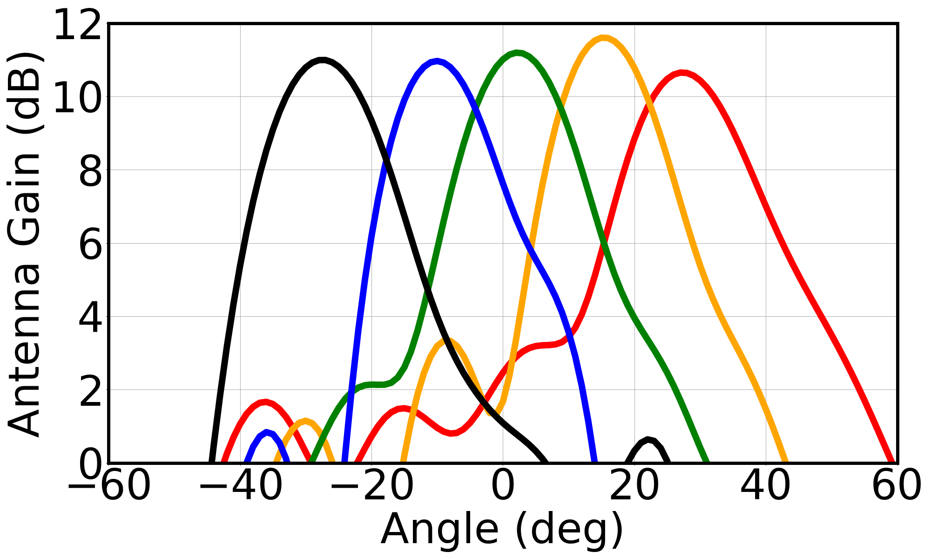
FSA Performance
5.49 GHz
5.57 GHz
5.66 GHz
5.75 GHz
5.80 GHz
FSA can be used to find the direction
Notes:
There is a mapping

Slide 18
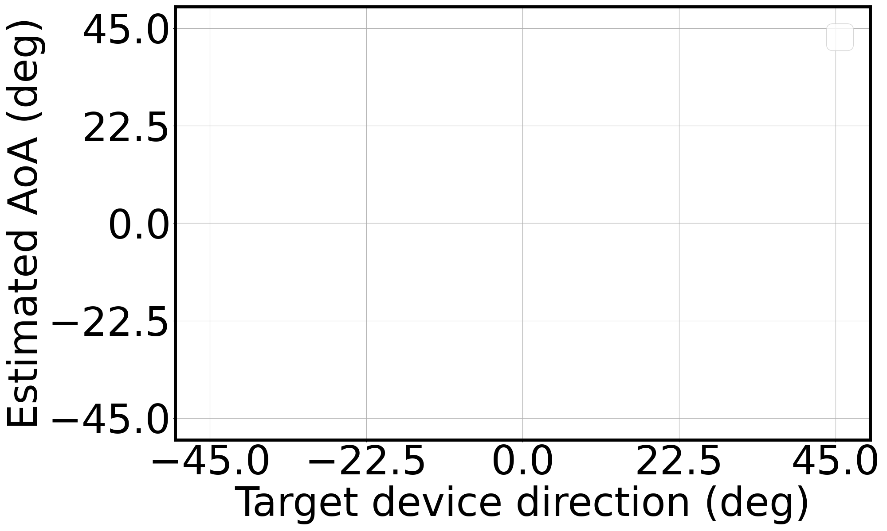
Direction Measurement
Direction
Notes:
Change y axis and descript the scenario.

Slide 19
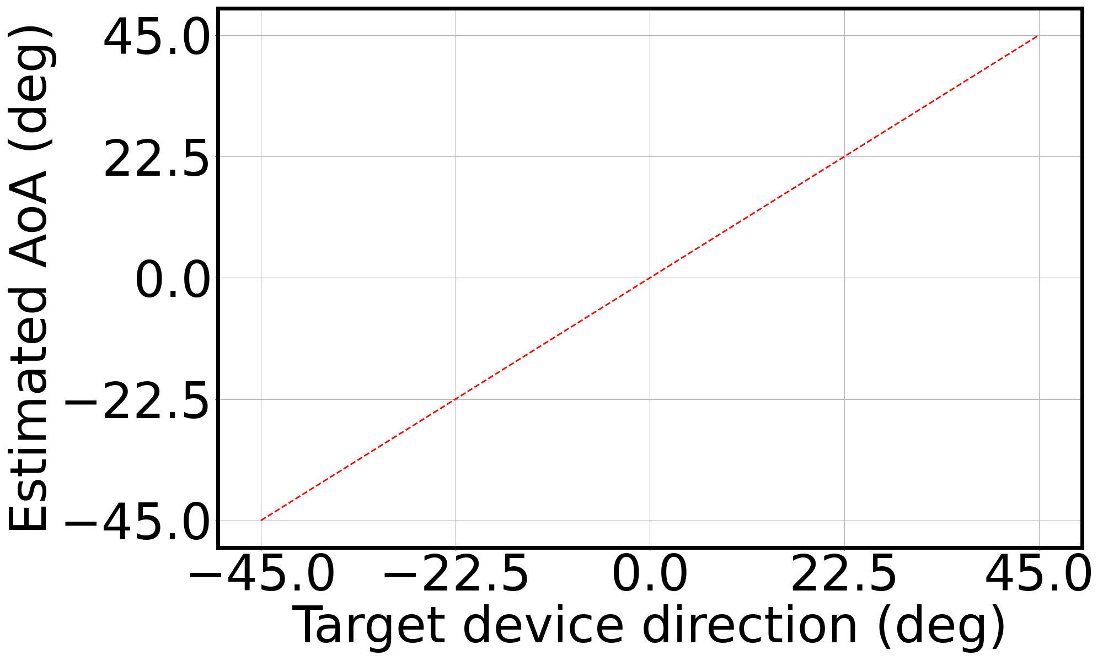
Direction Measurement
Direction
Notes:
Don’t show the whole figure immediate

Slide 20
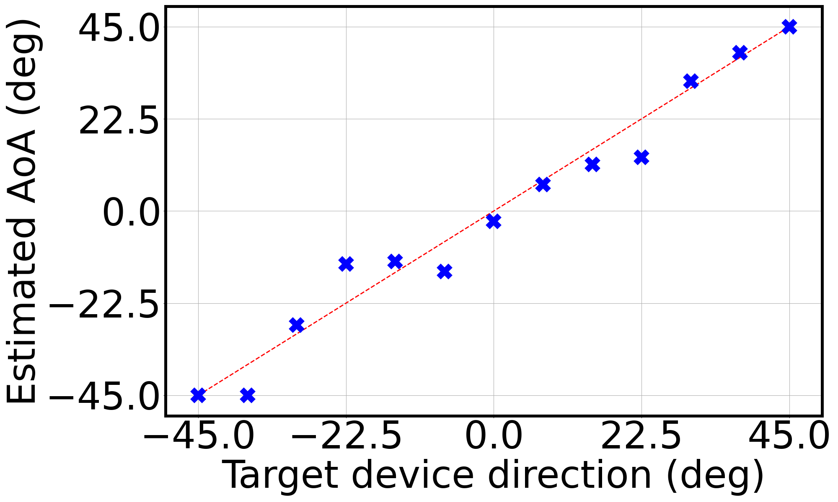
Direction Measurement
Direction estimation achieves high accuracy
Notes:
Don’t show the whole figure immediate

Slide 21
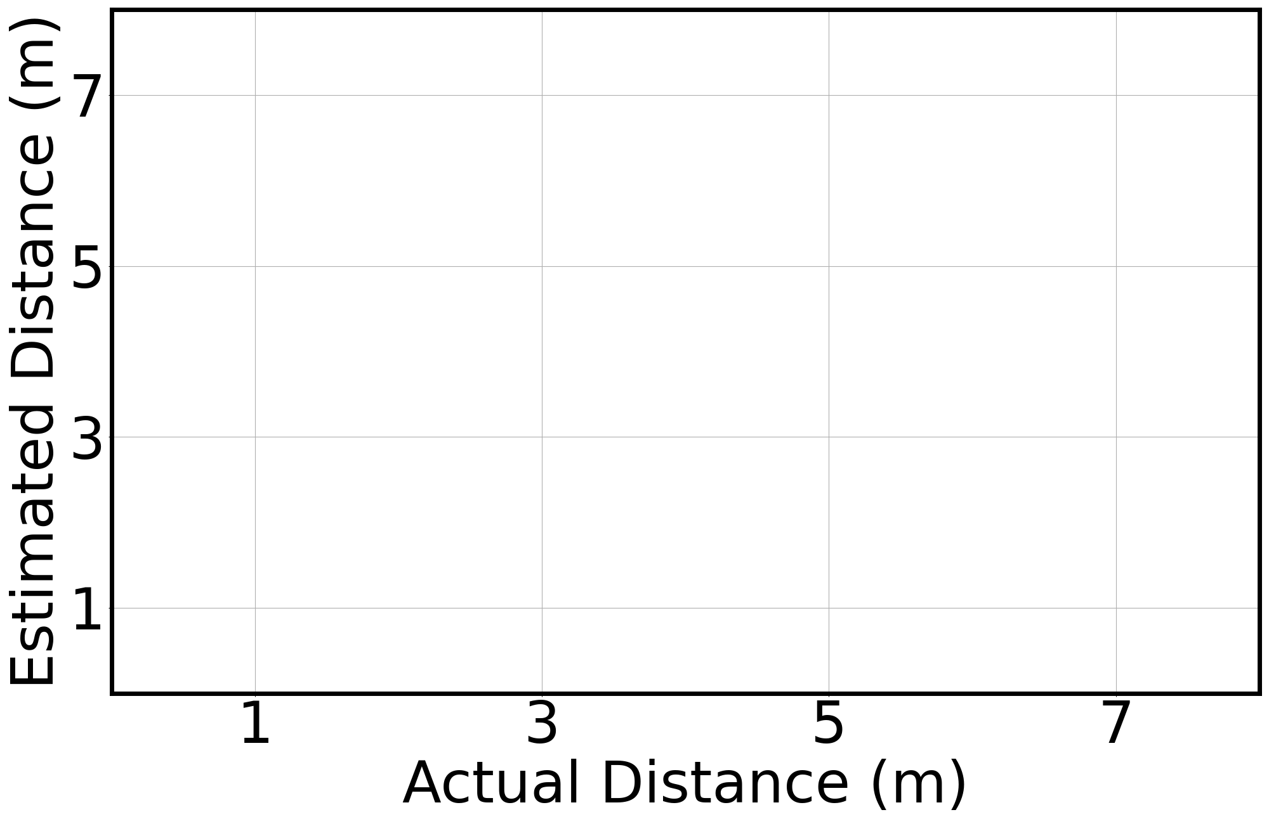
Distance Measurement

Slide 22
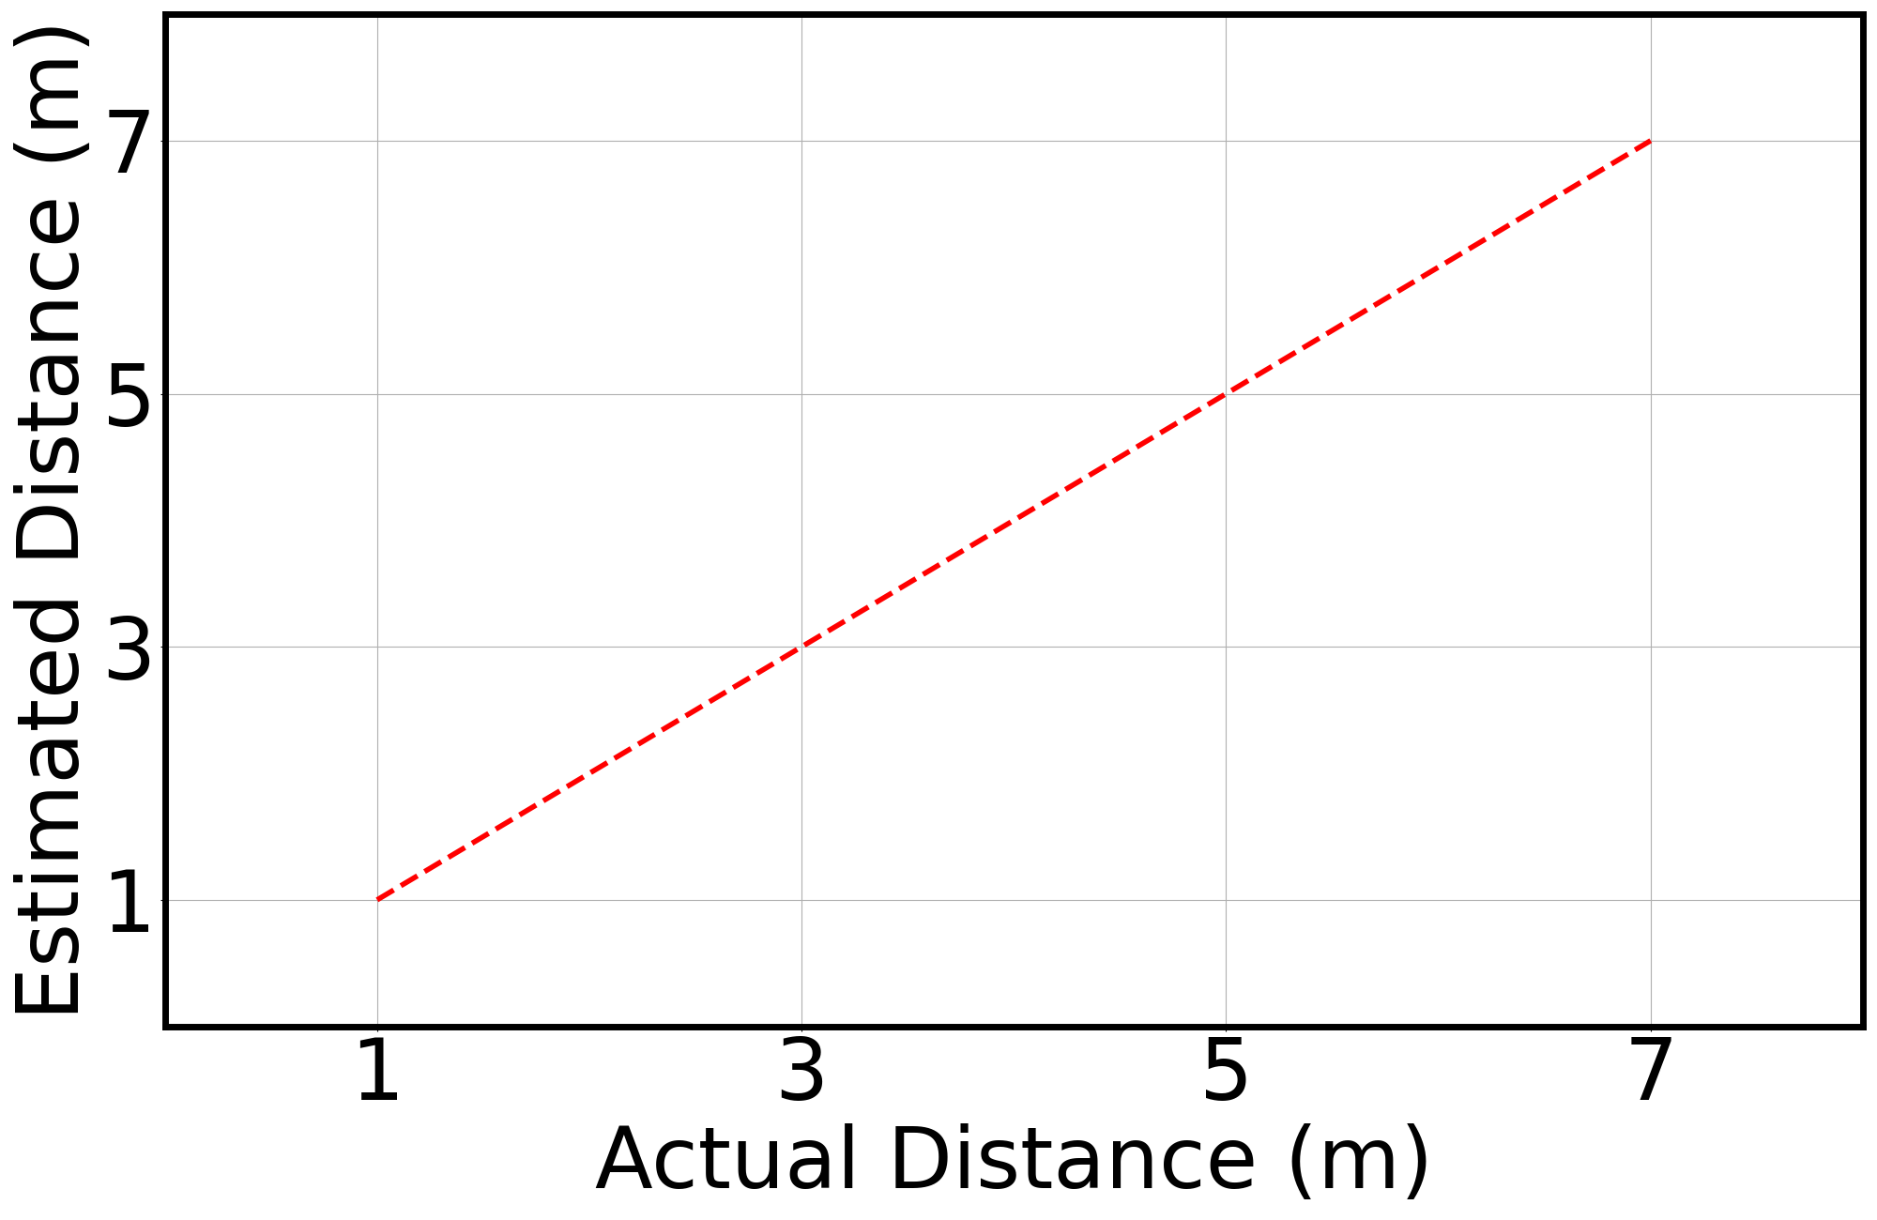
Distance Measurement

Slide 23
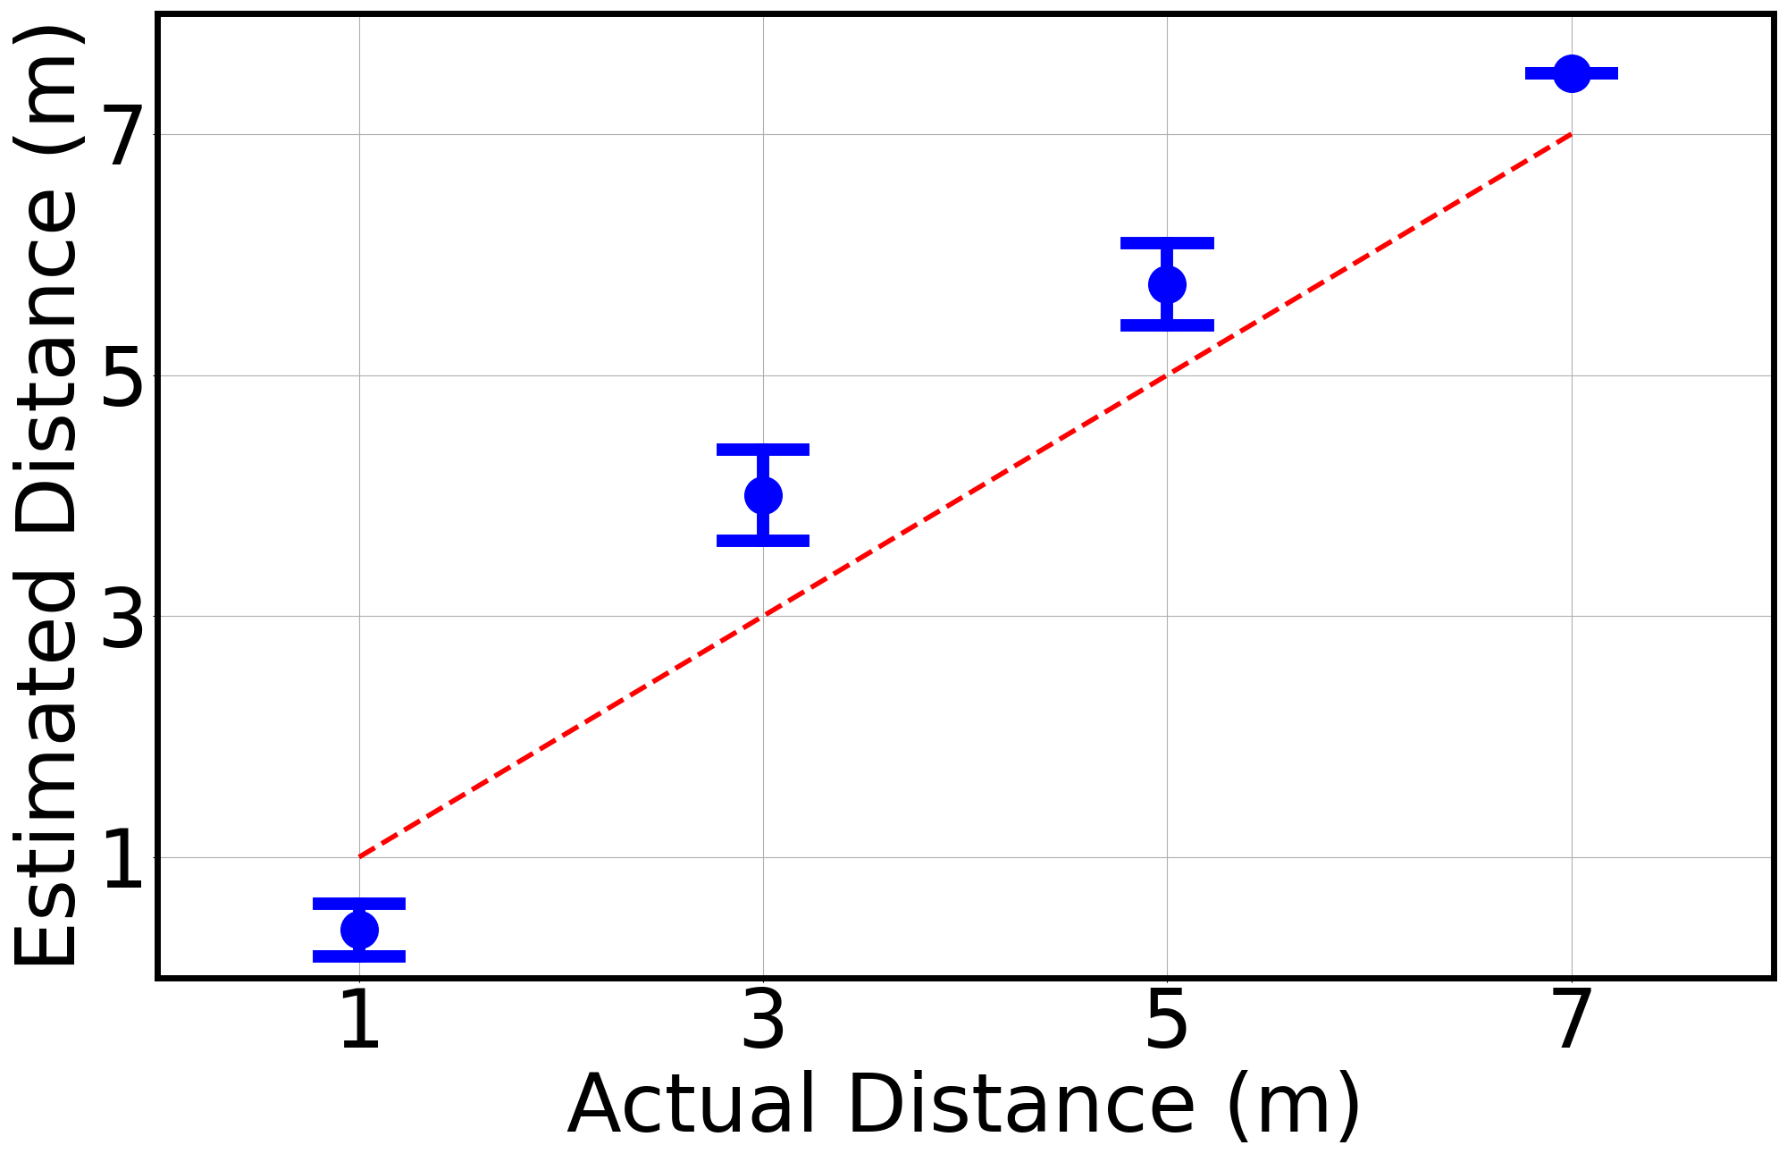
Distance Measurement
Distance measurement achieves a median error within one meter
Notes:
Say we have repeat this experiment at many position. 7m outside, less multipath. For 1, 3, 5 indoor more multipaths

Slide 24
Conclusion & Discussion
WiSight brings localization on any WiFi devices, even with a single transceiver chain.
Future research directions
Multipath effect
FSA scanning range
Integration into applications
Notes:
Enabling these new applications requires further research. Can skip the details of applications.
---
There are few challenges…

